Slide 1
TOPIC 8. ARRANGEMENT OF BASES AND FOUNDATIONS IN AREAS UNDER WHICH THERE ARE UNDERGROUND WORKINGS

Slide 2
Content
1. Undermining area
2. Protection measures for buildings and structures in the
undermining area
3. Geological protection measures
4. Geotechnical protection measures
5. Structural protection measures

Slide 3
UNDERMINING AREA
Undermining area is a territory on which uneven, rapid or gradual subsidence of the earth’s surface and settlement of the foundations of buildings or structures can occur as a result of underground mining activities.
Underworking of territories is mostly carried out for the following types of works:
• construction of underground structures for mining and extraction of coal and minerals;
• underground tunneling, collectors, construction of subways and other underground urban infrastructure;
• gas and oil production in large volumes, intensive pumping of groundwater.
DBN B.1.1-5-2000 “Building and structures on undermining territories and subsidiing soils". Buildings and structures on undermining territories. State Committee of Construction, Architecture and Building Policy of Ukraine. – [Ch. I.] – Kyiv: 2000. – 66p.

Slide 4
Trough – a depression appears on the earth’s surface due to horizontal and vertical shifts (inclination, curvature due tension or compression) which occur in connection with underground mining (Fig. 1,2). The magnitudes of the deformations depend on the depth and area of mining operations, the volume of soil extracted during tunneling or the construction of underground structures.
Dips and troughs formed on the surface vary in shape and size. For example, round shaped failures occur after the development of medium size reservoir deposits of thickness between 1.5–3 m and larger, with horizontal or slightly inclined occurrence.

Slide 5
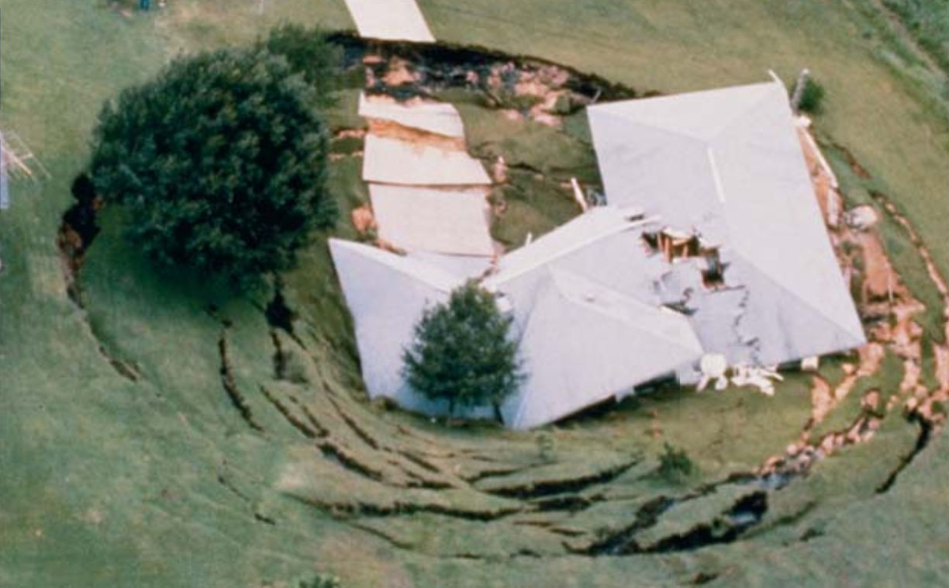
Fig.1. Destruction of buildings during the subsidence of the earth’s surface in the form of a trough

Slide 6
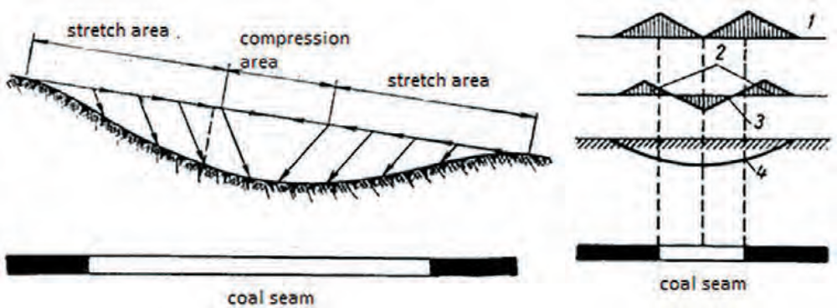
Fig. 2. The scheme of movement of the points of the earth’s surface (a) and the distribution of deformations in the subsidence trough during the development of the coal seam (b): 1 – horizontal displacement; 2 – stretching areas; 3 – compression area; 4 – surface subsidence

Slide 7
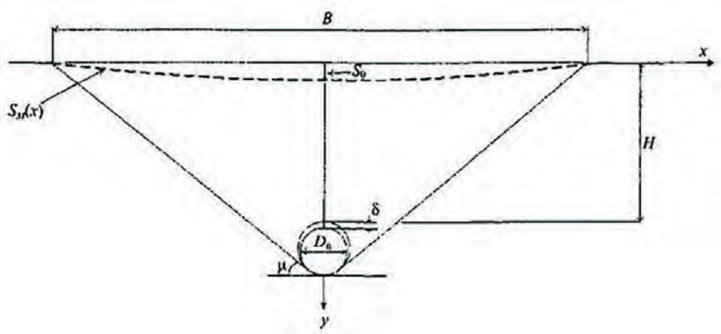
Fig.3. Scheme of the trough of subsidence over the underground tunnel excavation
S0 – the value of the maximum subsidence of the earth’s surface under the influence of underground mining, which normally occurs directly above the underground cavity;
B – the width of the trough, i.e. the distance between surface points at which subsidence is zero or not more than 10–15 mm;
Н – the depth of the roof of the worked-out space during the tunneling;
D0 is the characteristic size of the underground mine;
μ – boundary angle of displacement (angle of inclination of the lines connecting the output contour with the boundary points of the displacement trough);
δ – the amount of technological exhaustion (the difference between the actual diameter of the worked output and the outer diameter of the lining of the tunnel).

Slide 8
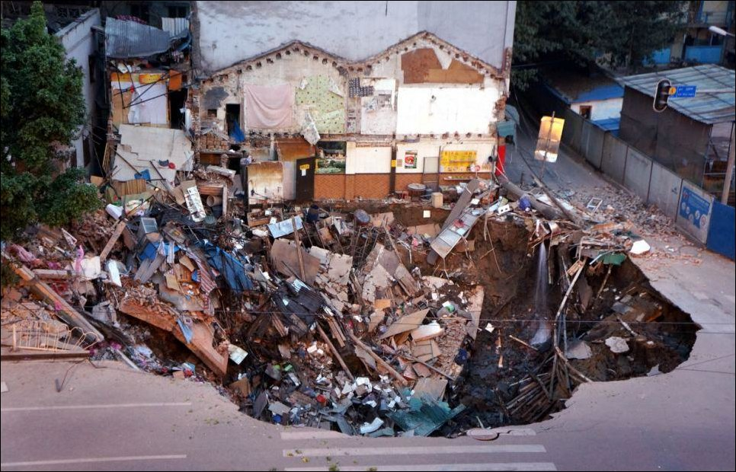
Fig. 4. Failure in the construction of subway in Guangzhou, China

Slide 9
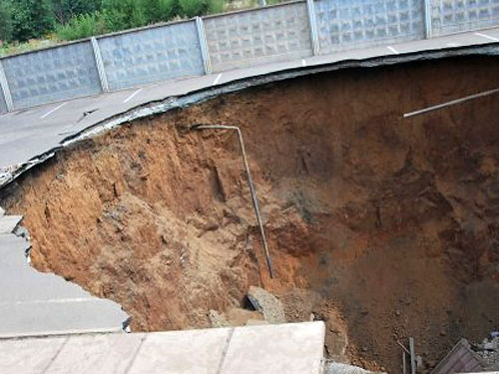
Fig. 5. Failure in the mined-out space during iron ore mining (the central market of the city of Kriviy Rig)

Slide 10
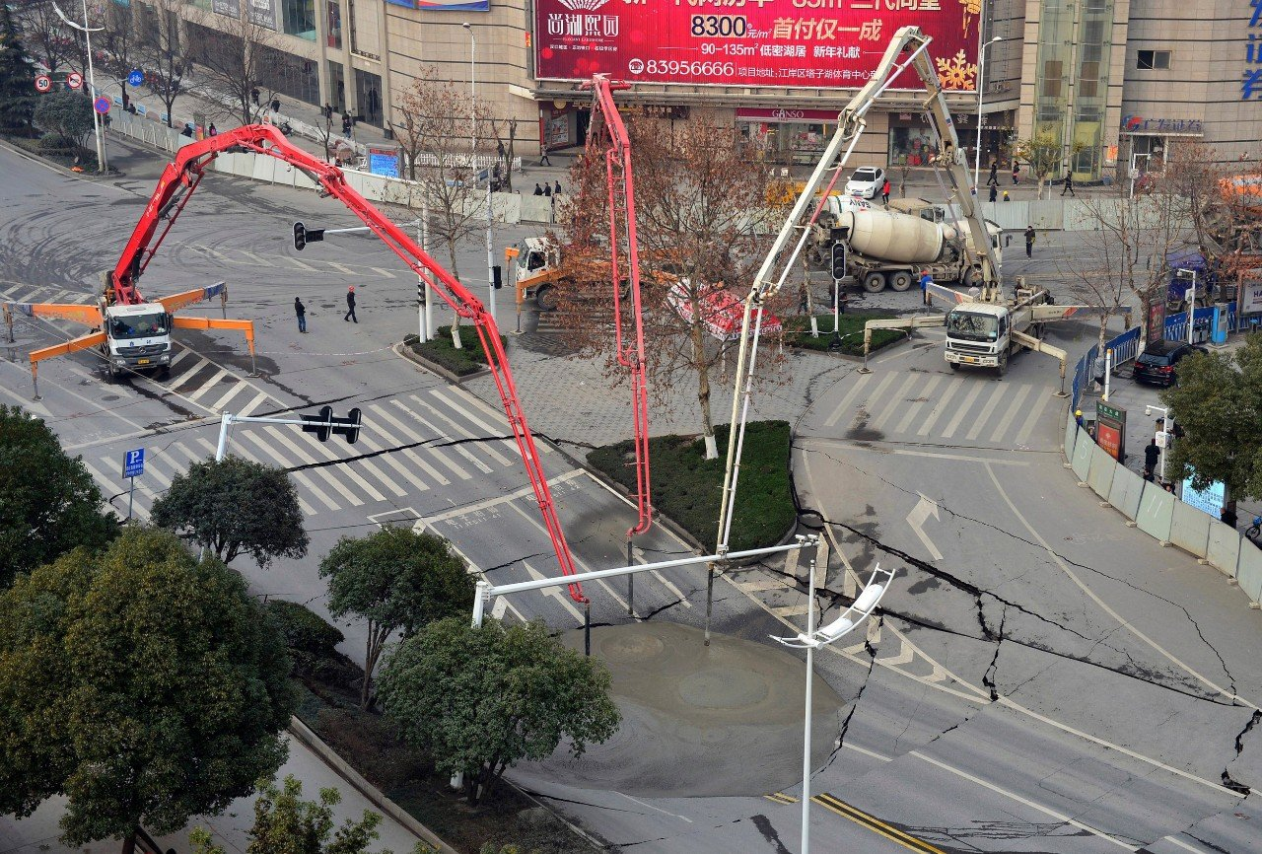
Fig. 6. Remediation of failure that occurred during the construction of a subway using concrete filling in Wuhan, China

Slide 11
PROTECTION MEASURES FOR BUILDINGS AND STRUCTURES IN THE UNDERMINING AREA
are carried out in accordance with regulatory documents and the following sets of measures are envisaged for the protection of buildings and structures under the influence of underground works:
a) geological and geotechnical, reducing or eliminating deformations of the foundations of buildings and structures;
b) structural, reducing the sensitivity of buildings and structures to deformations of their base, as well as deformations of ground structures.
Changes in the mode of operation and pre-planned repairs can also be considered as protection measures.

Slide 12
GEOLOGICAL PROTECTION MEASURES INCLUDE:
• full or partial filling of the developed underground space by borrowed material;
• development of formations within a time frame in an orderly sequence;
• do not completely extract all minerals, for stability of the area;
• preliminary strengthening and fixing of overlying formation, including the installation of advanced protective arches;
• the use of tunneling complexes with a closed face and compensating load;
• reduction of diameters and other geometric dimensions of mining areas;
• an increase in the distances between the mine works and the foundations of active buildings and structures;
• injection of cement and other hardening mortars into the space behind the lining.

Slide 13
GEOTECHNICAL PROTECTION MEASURES INCLUDE:
• measures to protect the soil of the base from deterioration and reduce deformation of the bases and their sensitivity to shifts;
• reinforcing the rigidity of foundations and frameworks of overlying buildings and structures;
• transfer of loads from buildings and structures to underlying soil layers which are not subject to deformations;
• separate the soil bases under influence of overlying buildings and structures by erection of retaining walls between separate mining zones;
• reduction of differential settlements and leveling of buildings and structures by method of soil extraction (drilling) from underneath the soles of foundations;
• compensatory injection of hardeners into the soil;• arrangement of temporary compensation trenches to reduce efforts from horizontal deformations of the bases.

Slide 14
STRUCTURAL PROTECTION MEASURES INCLUDE:
• separation of individual elements of buildings and structures with expansion joints;
• strengthening of individual structural elements or the whole structure reinforced concrete belts;
• installation of metal ties-struts;
• leveling the verticality of buildings and structures with jacks.

